Slide 1
Drone Piloting Drills
Manual and Autonomous Flight
Name:

Slide 2
Apps
App Icon | App Name | Platforms | Included Functionality
 | DroneBlocks | IOS, Android, Chrome | Coded flight Manual flight (Chrome only) Photography (IOS and Android Only)
 | Tello | IOS, Android | Manual flight and photography Intelligent flight modes Firmware updates
 | Tello Edu | IOS, Android | Manual flight and photography (some lag) Coded flight and photography Swarm programming

Slide 3
Instructions
Manual Flight
Practice the drills as shown by the animations on each slide
When you are ready to record your flight
Make sure the camera on the drone is on
Bring up the screen recorder on the Ipad and set it recording
Take off, fly that specific drill, then land
Stop the screen recorder
Put a copy of the video in the correct part of this presentation
Code for Autonomous Flight
Look carefully at the animations in the presentation to break it down into a range of lift, pitch, roll and yaw moves
Use the appropriate apps from the previous slide to build code to replicate those moves
Test the code with the drone to see if it performs as expected
Take a screenshot of your completed code and add it to this presentation

Slide 4
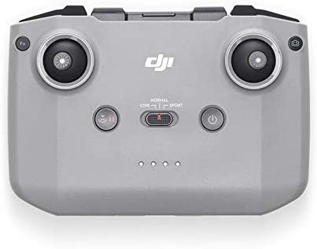
Manual Flight (Mode 2)
Climb
(throttle up)
Yaw Left Yaw Right
(throttle down)
Descend
Pitch Forward
Roll Left Roll Right
Pitch Backwards
Vertical Movement and Steering, Direction the Camera is Facing
Horizontal Movement

Slide 5
Simple Flight Drills
To complete these drills you only need to use one control stick and complete one movement at a time

Slide 6
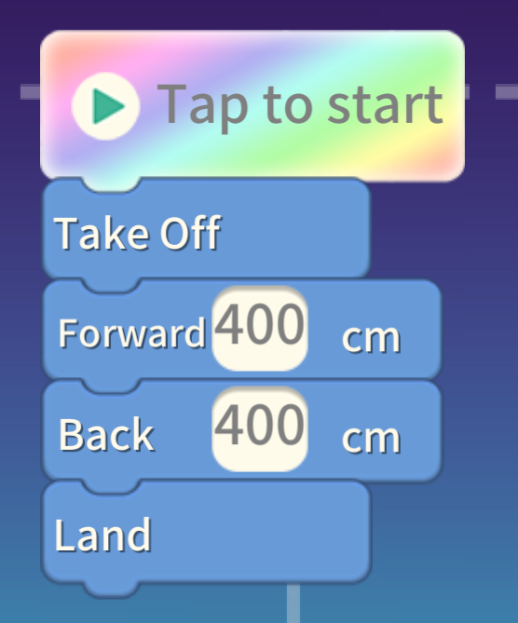
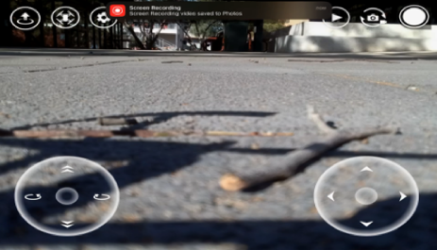
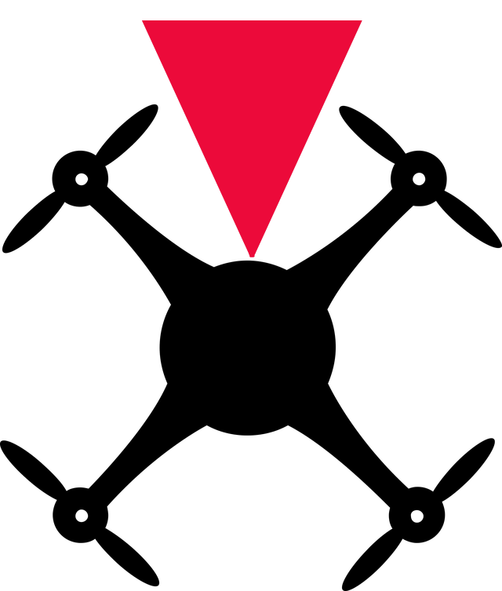
Straight Line - Away
Code for Autonomous Flight
Video of Manual Flight
Completed Example

Slide 7
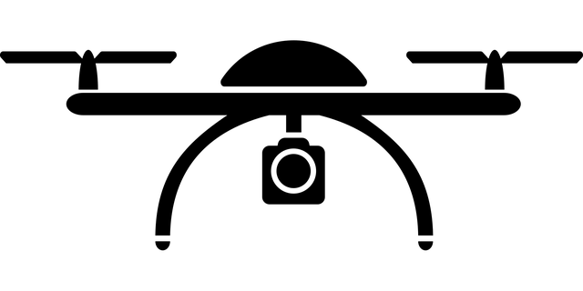
Vertical Rectangle
Code for Autonomous Flight
Video of Manual Flight

Slide 8
Straight Line – Away with Turn
Code for Autonomous Flight
Video of Manual Flight

Slide 9
Straight Line – Away -Sideways
Code for Autonomous Flight
Video of Manual Flight

Slide 10
Straight Line – Sideways with Turn
Code for Autonomous Flight
Video of Manual Flight

Slide 11
Horizontal Rectangle
Code for Autonomous Flight
Video of Manual Flight

Slide 12
Horizontal Rectangle with Turns
Code for Autonomous Flight
Video of Manual Flight

Slide 13
Intermediate Flight Drills
To complete these drills you only need to multiple stick and drone movements at the same time

Slide 14
Vertical Triangle
Code for Autonomous Flight
Video of Manual Flight

Slide 15
Vertical M Pattern
Code for Autonomous Flight
Video of Manual Flight

Slide 16
Rising Straight Line - Camera Away
Code for Autonomous Flight
Video of Manual Flight

Slide 17
Rising Straight Line - Camera Towards
Code for Autonomous Flight
Video of Manual Flight

Slide 18
Horizontal Rectangle – Rise and Descend
Code for Autonomous Flight
Video of Manual Flight

