Slide 1
Drone Flight Mechanics
Understanding how drones fly

Slide 2
Some Important Vocabulary
Hover | Hovering is where a drone stays in place whilst airborne, it does not change location, nor does it change altitude
Climb (throttle up) | Climbing is where a drone increases its altitude, and therefore gets higher in the air.
Descend (throttle down) | Descending is where a drone decreases its altitude, and therefore gets lower in the air.
Pitch | When a drone moves forwards, or moves backwards, we call this pitching. For the drones we use, pitching forward means moving in the direction that the camera is facing.
Roll | When a drone moves sideways, either left or right, we call this rolling. When describing rolling we describing it from the perspective of the drone, like we are sitting in it.
Yaw | This is a movement where the drone rotates without a change of position, this is the equivalent of turning around on a swivel chair.

Slide 3
Explaining Drone Flight and Movement
When you look at a drone carefully you can see there are two different types of rotor blades.
The ones diagonally opposite each other are the same and spin in the same direction
The adjacent pairs (ones next to each other, front to back or side to side) are different to each other, these spin in opposite directions.

Slide 4
Explaining Drone Flight and Movement
But why is this important? Why can't they all just spin in the same direction?
Newton's third law of motion which states that "for every action, there is an equal and opposite reaction".
Therefore if all the blades are spinning in the same direction, then the drone itself would try to spin in the opposite direction.
https://youtu.be/5cRb0xvPJ2M

Slide 5
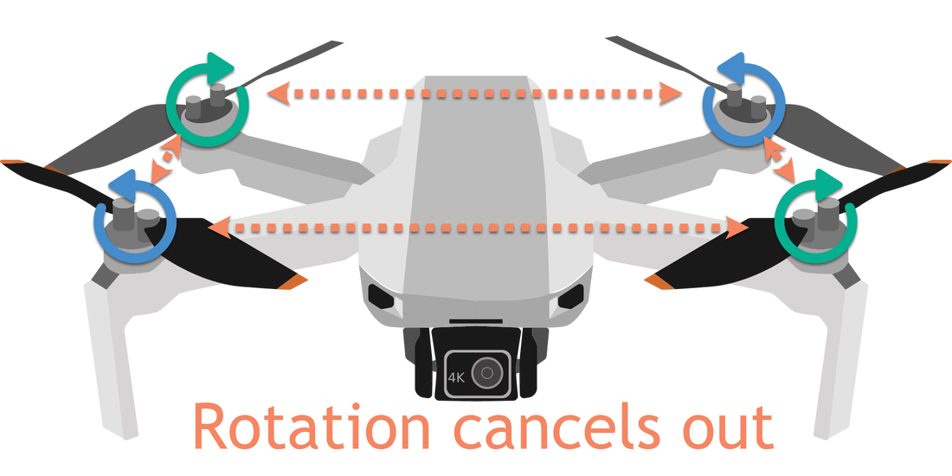
Explaining Drone Flight and Movement
By spinning adjacent rotors in different directions we are able to cancel out that effect
One of the rotors is trying to rotate the drone one way, and the other one is trying to spin it the other way
This gives an overall effect of no rotation.

Slide 6
Hovering
In order for a drone to hover, all of the rotors need to run at the same speed (as shown by the yellow bars).
The rotors need to run just fast enough that the force of lift made by the rotors is equal to the force of gravity on the drone.
The rotors are pushing the drone up just as much as gravity is pulling the drone down.

Slide 7
Climbing (and descending)
In order for a drone to climb, all of the rotors need to run at the same speed (as shown by the yellow bars).
They need to run faster than they do when hovering.
The increased speed, creates increased lift, and therefore the force of lift is more than the force of gravity, and therefore the drone rises.

Slide 8
Pitching
In order for a drone to pitch forward. The motors at the back of the drone speed up, and the ones at the front slow down.
This causes the back to lift and the nose to fall. Therefore the rotors are pushing air backwards slightly, causing the drone to move forward.
The more you speed up the back rotors and slow down the forward ones, the faster it will go.

Slide 9
Rolling
In order for a drone to roll left. The motors on the right side of the drone speed up, and the ones on the left side slow down.
This causes the right side to lift and the left side to fall. Therefore the rotors are pushing air to the right slightly, causing the drone to move left.
The more you speed up the right rotors and slow down the left ones, the faster it will go.

Slide 10
Yawing
Yawing is quite different to the other movements.
As we stated previously we have rotors moving in opposite directions to prevent rotation of the drone.
If we want to turn the drone anticlockwise, we speed up the rotors that are moving clockwise and slow down the ones moving anticlockwise, this allows the rotation to take over a bit.

Slide 11
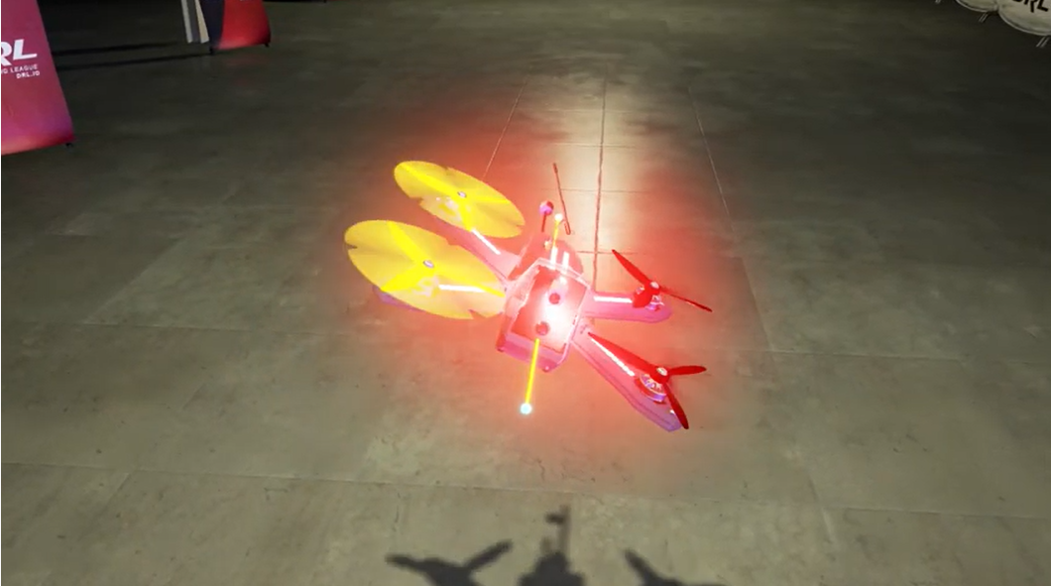
Seeing it in Action
This video gives a quick video explanation of the movments that are looked at above with relation to racing drones https://www.youtube.com/watch?v=aCKt8itCCy4
The video below is one that uses a high speed camera to show the relative speed of the blades for different movements. https://www.youtube.com/watch?v=-rL4-6TvX1c

