Slide 1
Drone Safety Rules
Rules you must abide by in order to fly

Slide 2
Ensuring Safety
Although flying drones can be a lot of fun, they also can pose some serious risks if the rules are not followed. Therefore the following measures will be put in place for this unit of work.
Before you are able to fly the drones, you must pass a safety test on operating the drones, this will cover both the CASA requirements and how they are applied in a school context. The minimum passing mark for this test is 80%. This is a score of 12/15
Failure to follow the safety requirements will mean that you will be banned from flying the drones for a period of time. The length of time imposed for this ban will be determined by your teacher

Slide 3
CASA Recreational Drone Rules

Slide 4
CASA ‘Flying for Fun’ Rules
CASA, or the Civil Aviation Safety Authority, are the government agency that are responsible for safety in the skies.
They are therefore responsible for ensuring that rules are put in place for how drones can be operated.
An explanation of those rules can be found in the video link below https://www.youtube.com/watch?v=-urP2fIJYk8

Slide 5
Maximum Altitude
CASA Requirement Drones must be kept lower than 120 m above ground level at all times
School Context The drones must be kept lower than the roof or fence line if flying the drones inside the school. On the school or Braddock oval they should be kept lower than the tree tops. This will help ensure drones cannot leave the area

Slide 6
Proximity to People
CASA Requirement You must keep your drone at least 30 metres away from other people
School Context We will fly the drones in areas clear of people and use signage to show drones are operating in the area, this will provide the 30 metre exclusion area. Drones should be manoeuvred away from people and land if they need to move through the area. Spotters will assist the pilot identifying people

Slide 7
Proximity to Controlled Airports
CASA Requirement If your drone ways more than 250 grams, you must fly at least 5.5 km away from a controlled airport (one with a control tower).
School Context There is no controlled airport in Port Augusta, and none of the drones you will be flying are more than 250 grams. Therefore this rule will not apply to any of our flying

Slide 8
Flying Near Smaller Airports
CASA Requirement If you are within 5.5 km of a helicopter landing site or aerodrome, and you become aware of a manned aircraft in the vicinity, you must manoeuvre away and land safely and quickly
School Context The entire school, including Braddock, sits in such an airport zone. When flying outside this rule applies and you should land when given such an instruction by your teacher. When flying inside there is no need to land.

Slide 9
Only One at a Time
CASA Requirement You must fly only one drone at a time
School Context You will only ever have control over one drone at a time and therefore this requirement will always be met.

Slide 10
Keeping Eyes on Your Drone
CASA Requirement You must keep the drone within visual line-of-sight. This means always being to see the drone with your eyes, and not through screens.
School Context There will always be a maximum of one drone between two people, one will act as the pilot, and the other as a spotter who will always keep their eye on the drone and looking for hazards. The maximum heights in the school context mean you should never be flying above or behind buildings and trees.

Slide 11
Flying In Populous Areas
CASA Requirement You must not fly over or above people, or in areas with large numbers of people. This could include beaches, parks, events or sports ovals.
School Context We will not be flying drones above people or in areas where there are large numbers of people.

Slide 12
Respect Privacy
CASA Requirement Respect personal privacy. Don’t record or photograph people without their consent
School Context When using the drones at school we will using them to take photos of parts of the school, not people. Where photos of people are taken, they will be taken in accordance with school policy.

Slide 13
Do not Create a Hazard
CASA Requirement Operate in a way that does not cause a hazard to another aircraft, person, or property
School Context With the highway being close to the school and Braddock we need to be very aware of the road. Keeping the drone below fence and tree heights will reduce the chance of a drone going over the road, but you should fly no closer than 10 metres from the fence.

Slide 14
Flying in Reduced Visibility
CASA Requirement You must only fly during the day and you must not fly through cloud or fog.
School Context As they are being used for school we will only ever operate during the day. When weather is bad (such as fog) we will not fly or will fly inside.

Slide 15
Flying Near Emergency Situations
CASA Requirement You must not fly a drone over or near an area affecting public safety or where emergency operations are underway. This may include car crashes, fires, police operations, or search and rescue
School Context As we will flying drones at school this issue should not present itself, however if it does the drones will be landed immediately.

Slide 16
Flying a Drone Commercially
CASA Requirement There are additional rules if you intend to fly your drone for or at work
School Context The use of drones at school are part of the curriculum and therefore no additional requirements are needed if flying only for school curriculum purposes.

Slide 17
Other Safety Procedures

Slide 18
Pre and Post Flight Checklists
These will be completed before and after each flight to ensure that the area is safe to by flying in and that the aircraft is performing as expected.

Slide 19
Spotters
Although the pilot will generally be looking at the aircraft in order to pilot it. There are times that looking at the screen will be more appropriate. In this case the spotter will look at the aircraft and communicate required information to the pilot using verbal commands or hand signals

Slide 20
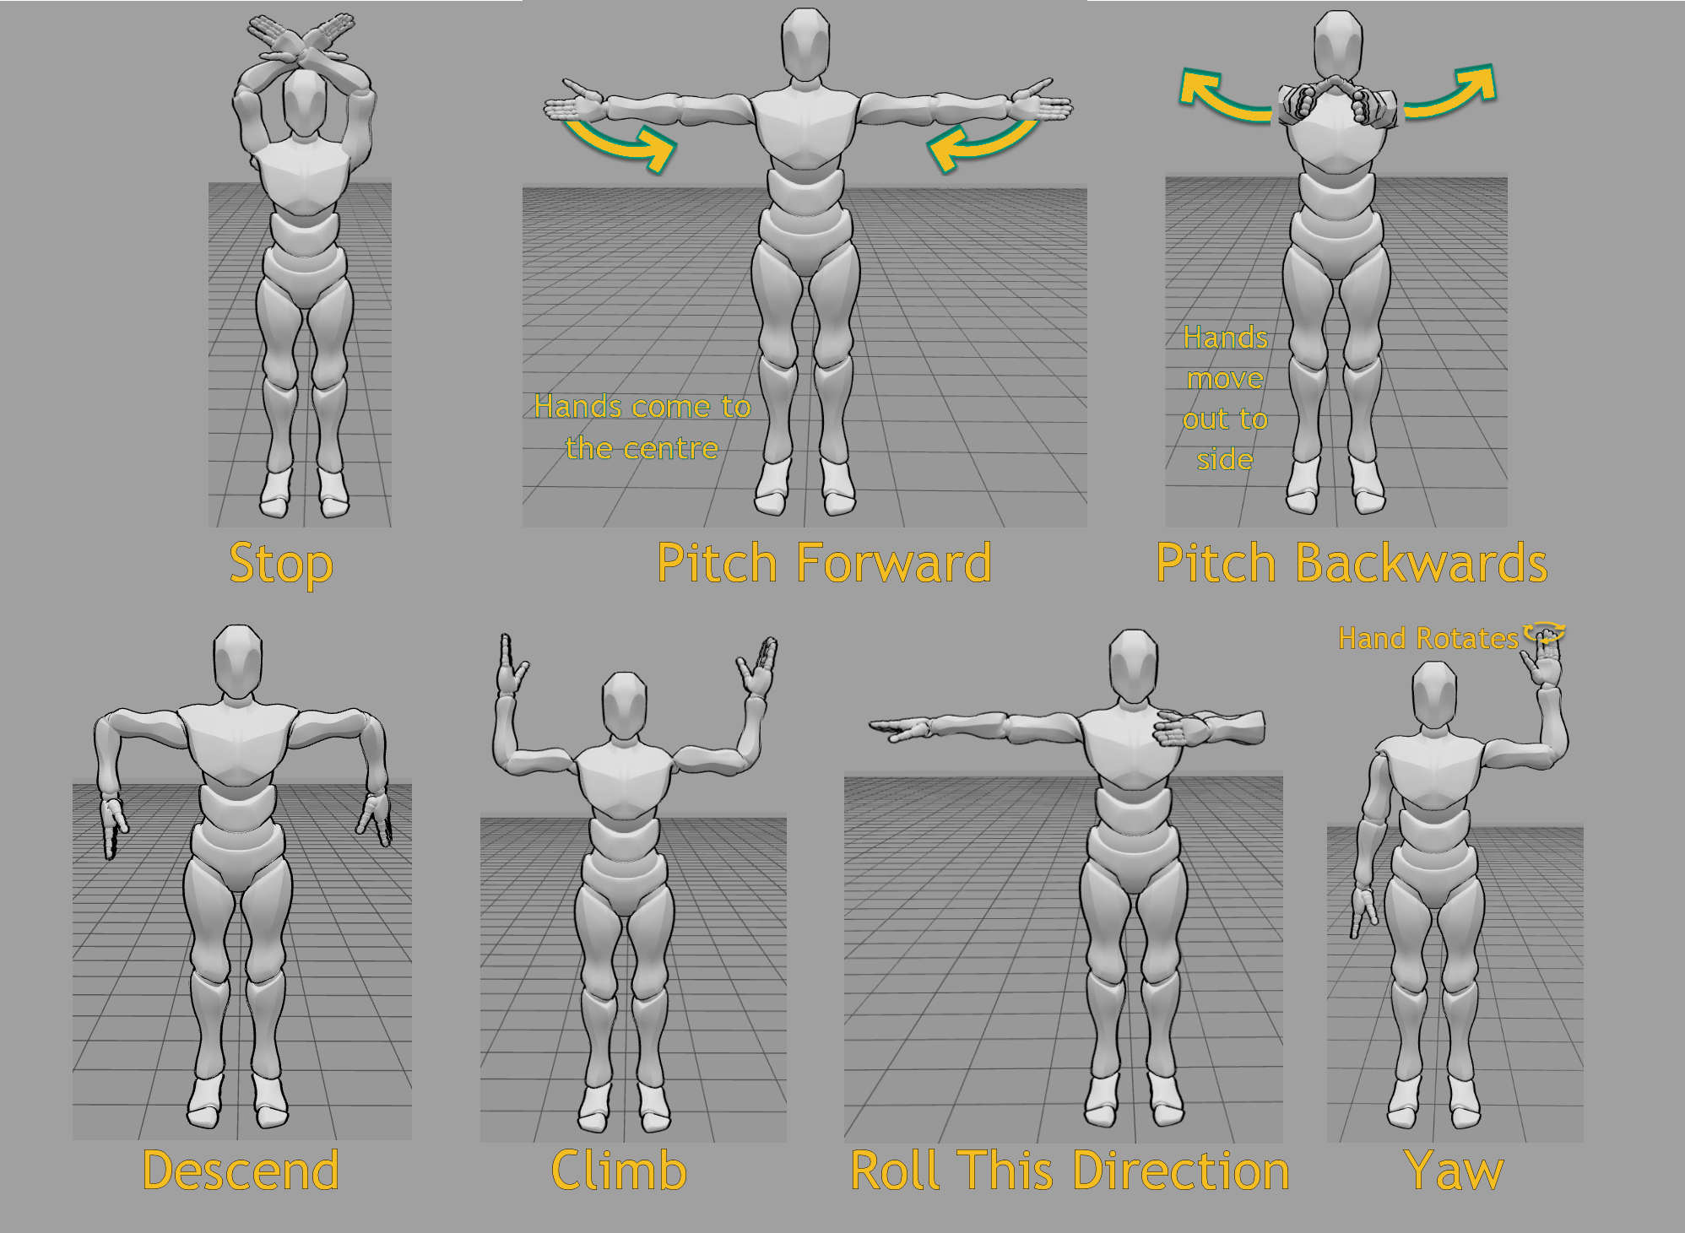
Hand Signals
The hand signals shown opposite allow for the spotter to send messages to the pilot from a greater distance than could be done verbally. They incorporate all of the major aircraft movements.

Slide 21
Birds
Birds have been known to shown an interest in drones and will sometimes attack them. In the case that a bird is flying towards your drone you should fly straight up as quickly as possible as the drone can climb faster than a bird.

