Slide 1
Pre-Flight and Post-Flight Checks
Ensuring each flight is safe and a success

Slide 2
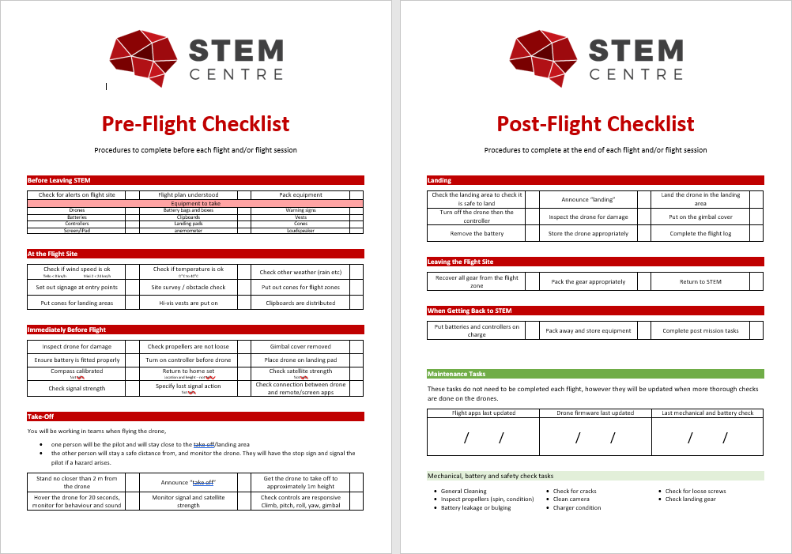
Introduction
A drone, like any other aircraft, can pose a significant risk to the safety of others if they run into trouble
Therefore it is important the pre and post flight checks are done in order to ensure that the drone is safe to fly, and that we are flying them in safe conditions
These checks need to be done before every flight

Slide 3
Before Leaving STEM
Check for updates and alerts that may influence whether the drone can fly in the intended area, this can found in flight safety apps such as ‘Can I Fly There’ and checking NOTAM’s (notice to airmen)
Ensure that the flight plan is understood
Ensure that all required equipment is packed
Gear to pack
Drones
Batteries
Controllers
Screen/iPad
Clipboards
Landing pads
Anemometer
Waring signs
Whistle
Cones
Aviation Radio

Slide 4
At the flight site
Check if the wind speed is ok
Tello < 8 km/h mini 2 < 24km/h
Check if the temperature is ok (0 - 40°C)
Check other weather conditions (e.g rain)
Set signage out at entry points to area
Site survey and obstacle check
Trees, fences, places people may enter, powerlines and mobile phone towers
Put cones out to identify flight zones, hazards, and landing areas
Ensure clipboards are distributed and match the aircraft number

Slide 5
Immediately before launch
Inspect drone for any damage
Cracks in frame, damage to propellers
Check propellers are not loose
Remove the gimbal cover (not tello)
Ensure battery is fitted properly
Turn on the controller, then the drone
Place the drone on the landing pad
Compass calibrated (not tello)
Return to home height and location set (not tello)
Check satellite strength (not tello)
Check signal strength
Specify lost signal action (not tello)
Check the connection between the drone and remote/screen apps

Slide 6
Take-off
To operate the drone you will be working in teams
One person will be the pilot and will stay close to the take-off/landing area
One person will stay a safe distance from, and monitor, the drone. They will signal the pilot if a hazard arises
Stand no closer than 3m from the drone
Announce “Take-off”
Get the drone to take off to approximately 3m height
Hover the drone for 10 seconds, monitor the behaviour and sound to check that there are no problems
Monitor the signal and satellite strength
Check the drone responds as expected, climb, pitch, roll, yaw, gimbal

Slide 7
Landing
Check the landing area to see if it is safe to land
Announce “Landing”
Land the drone on the landing pad, or in the landing area
Turn off the drone and then the controller
Inspect the drone for damage
Put on the gimbal cover
Remove the battery
Store the drone it it’s case
Complete the flight log

Slide 8
Leaving the Site and Returning to STEM
When you are getting ready to leave the area in which you are flying
Recover all equipment from the flight zone
Pack the gear appropriately
Return to STEM
When back in STEM
Put all batteries and controllers on charge
Pack away and store equipment appropriately
Complete the post mission tasks

